Slide 1
TITLE OF PRESENTATION (24PT. ARIAL, BOLD, ALL UPPERCASE)
Network Rationalization Update
November 25, 2014
Subtitle
(20pt. Arial, Bold, Title Case)
Dave Williams
FOOTER (10PT. ARIAL, BOLD, GREY, CAPS)

Slide 2
Concept of 24-Hour Plant Operations
Continuous
DPS/Secondary
Operations
(12:00 PM – 6:00 AM)
Outgoing
Operations
(5:00 PM – 12:30 AM)
24:00
Continuous
Remittance/Caller Service
Processing
0800-0600
18:00
06:00
08:00
12:00
Incoming
Primary
Operations
(8:00 AM – 12:00 PM)
BMEU
(8:00 AM – 7:00 PM)

Slide 3
Periodicals CET Matrix – Phase II Service Standard Change
Periodicals CETs – Under Phase II Service Standard Change
Type |  | No Bundle Sort Needed 5-Digit / Scheme Container | Bundle Sort Needed 3-Digit and Up Container | Direct 5 Digit Carrier Route Pallets
Non FSS |  | 1400 | 1100 | 1700
FSS |  | 1100 | 0800

Slide 4
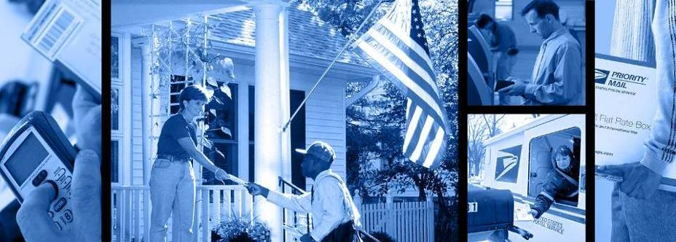
Thank You
Questions?

Slide 5
TITLE OF PRESENTATION (24PT. ARIAL, BOLD, ALL UPPERCASE)
Subtitle
(20pt. Arial, Bold, Title Case)
FOOTER (10PT. ARIAL, BOLD, GREY, CAPS)

